Slide 1
Oct 14 Math Club

Slide 2
Dissecting the Nobel Prize : A Peek at the Hopfield Network

Slide 3
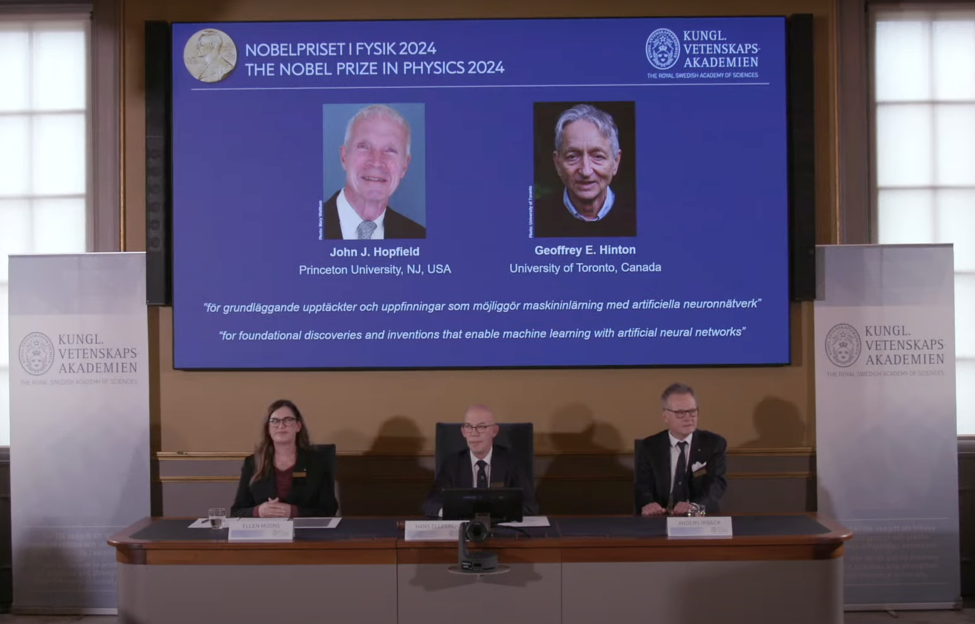
2024 Nobel Prize in Physics
Nobel Prize, “Announcement of the 2024 Nobel Prize in Physics,” YouTube. Oct. 08, 2024. Available: https://www.youtube.com/watch?v=SBGG4WNweEc

Slide 4
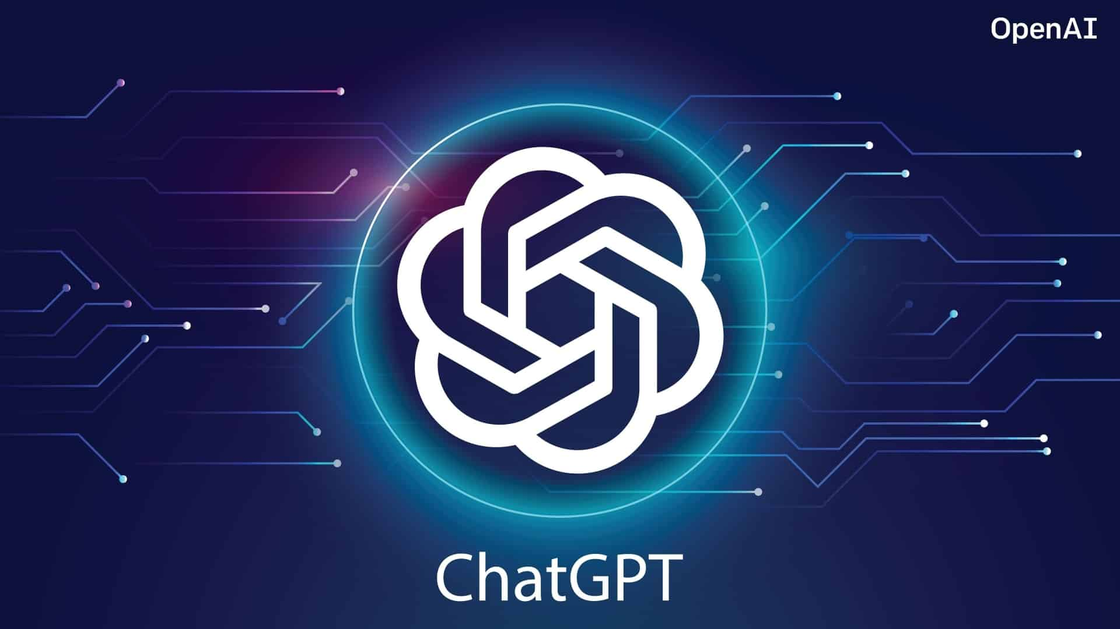
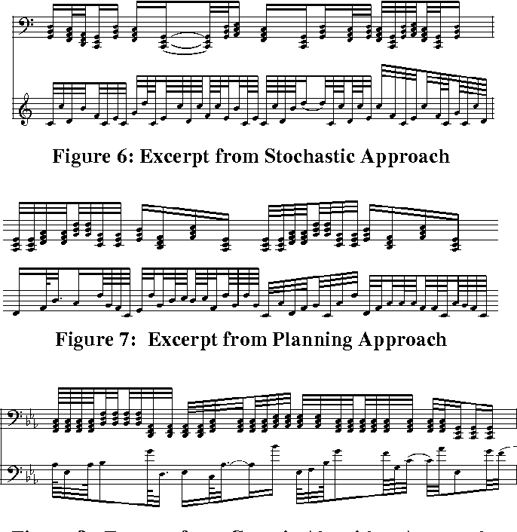

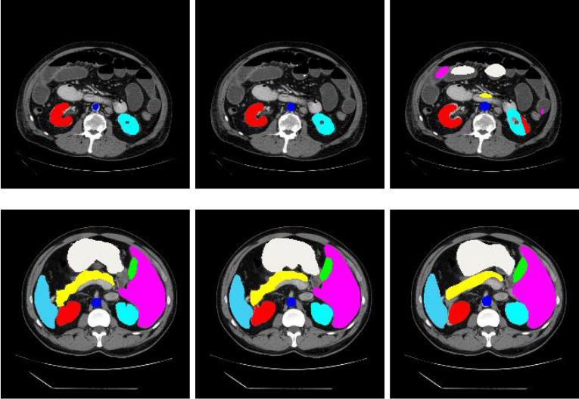
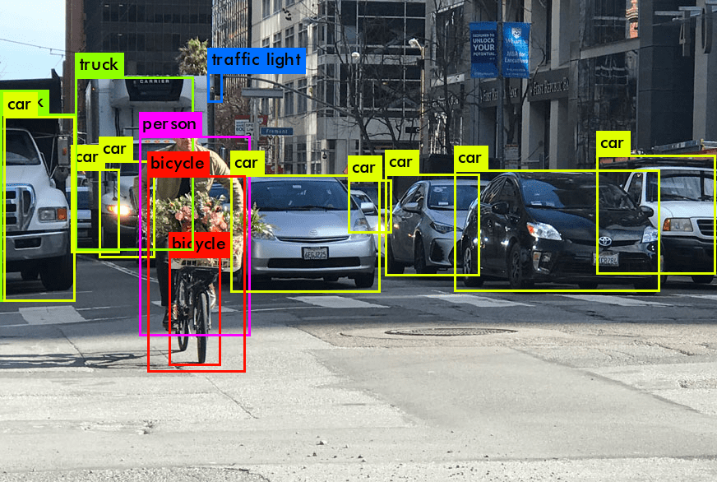
Machine Learning

Slide 5
What does it mean to learn / memorize?
Recall
Memory
Learning
Stimulation

Slide 6
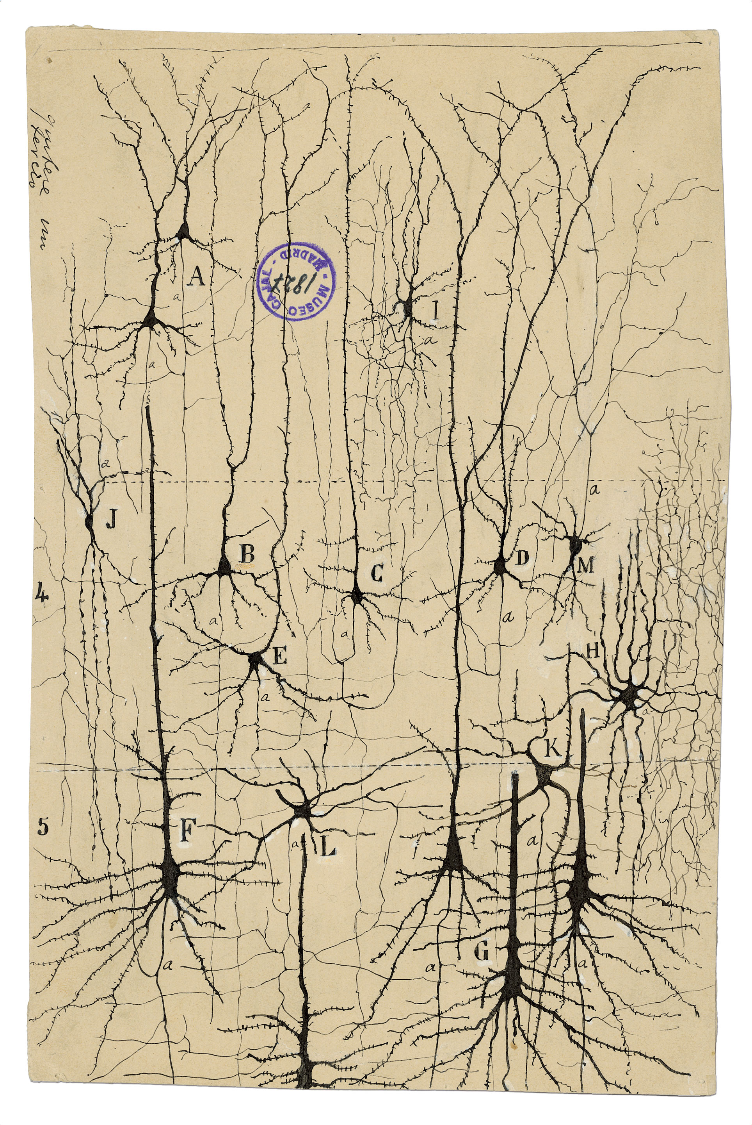
How do we learn?
M. Fessenden, “Revel in these wondrous drawings by the father of neuroscience,” Smithsonian Magazine, Jan. 20, 2017. Available: https://www.smithsonianmag.com/arts-culture/revel-these-wondrous-drawings-father-neuroscience-180961881/

Slide 7
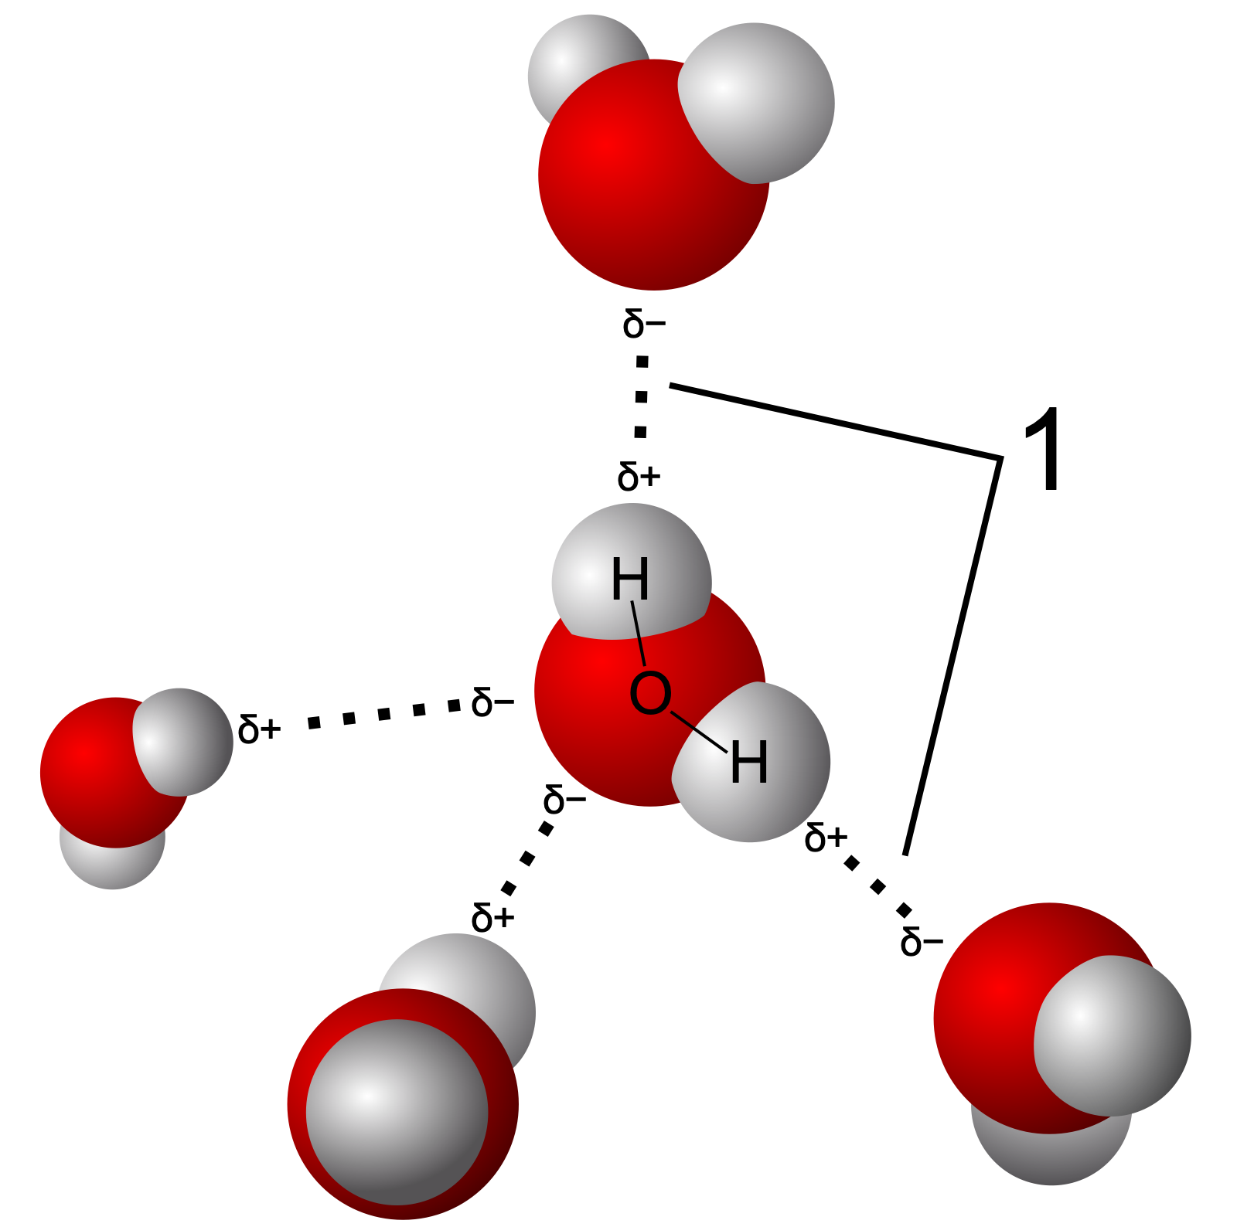

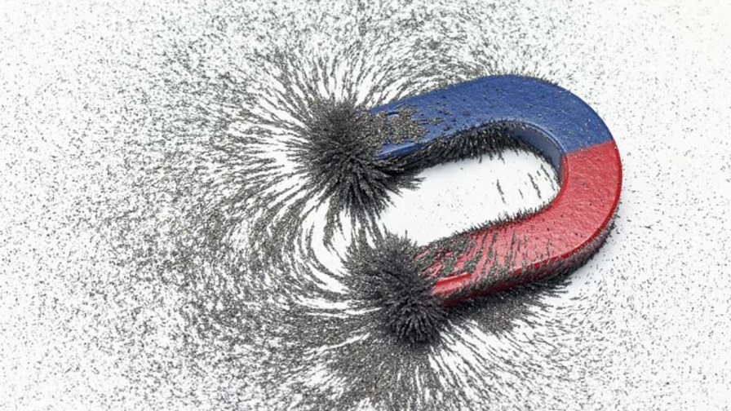
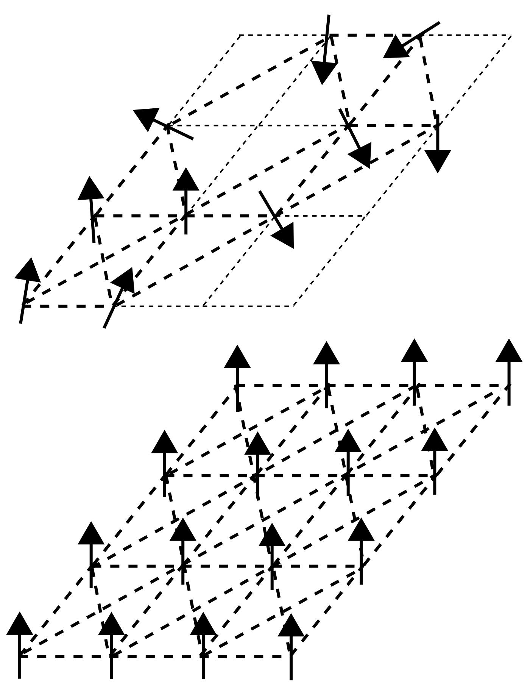
Can nonliving things memorize?
Wikipedia contributors, “Snowflake,” Wikipedia, Oct. 02, 2024. Available: https://en.wikipedia.org/wiki/Snowflake#/media/File:Snowflake_(lumehelves).jpg
Wikipedia contributors, “Water,” Wikipedia, Oct. 12, 2024. Available: https://en.wikipedia.org/wiki/Water#/media/File:3D_model_hydrogen_bonds_in_water.svg
Stanford Magnets, “What is the strongest part of a magnet? | Stanford Magnets,” Stanford Magnets. Available: https://www.stanfordmagnets.com/what-is-the-strongest-part-of-a-magnet.html
Wikipedia contributors, “Spin glass,” Wikipedia, Oct. 09, 2024. Available: https://en.wikipedia.org/wiki/Spin_glass#/media/File:Spin_glass_by_Zureks.svg

Slide 8
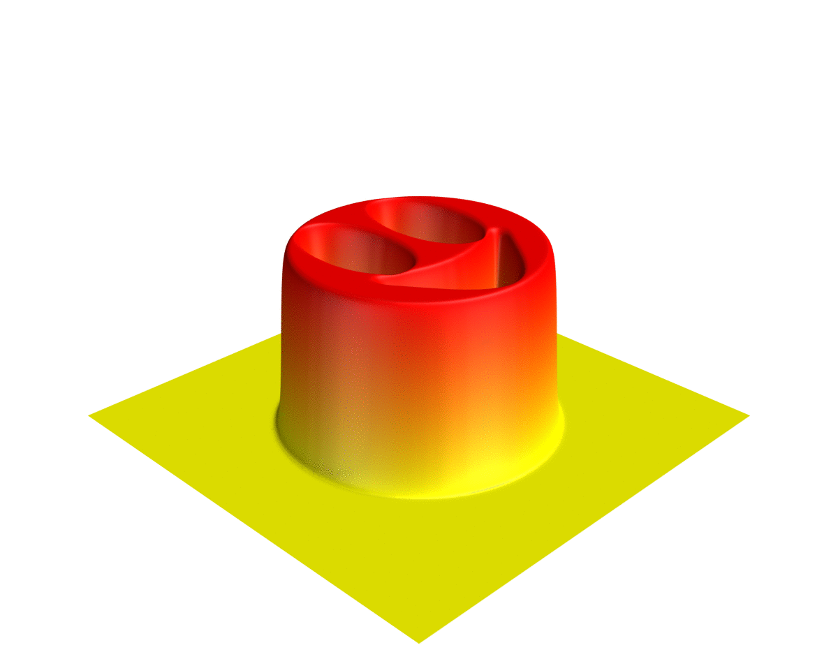
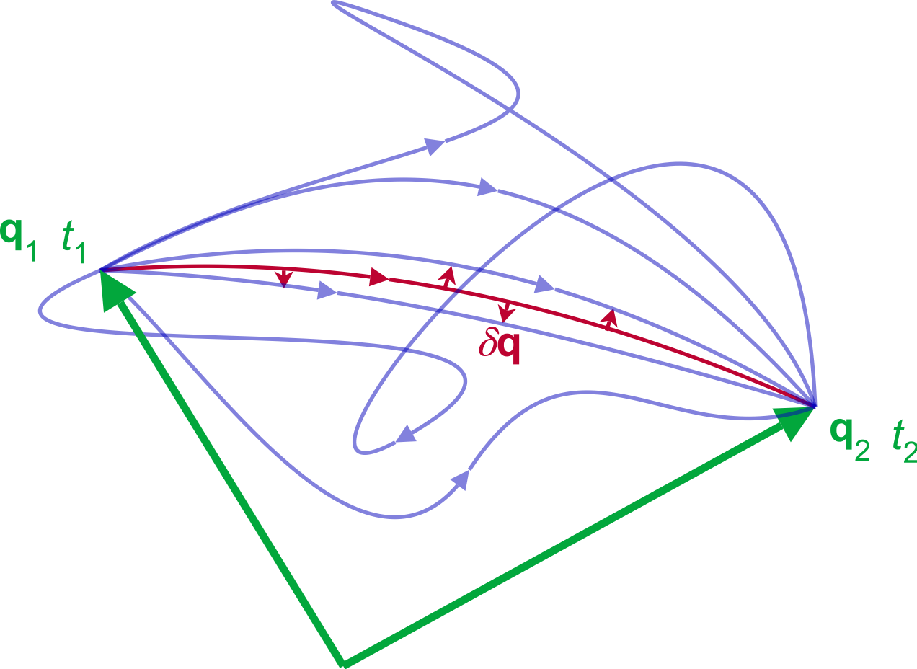
The Principle of Minimal Energy
Minimal Action
Second Law of Thermodynamics
“principle of least action,” Wikidata. Available: https://www.wikidata.org/wiki/Q722799#/media/File:Least_action_principle.svg
File:Heat Smiley.gif - Wikimedia Commons. 2017. Available: https://commons.wikimedia.org/wiki/File:Heat_smiley.gif

Slide 9
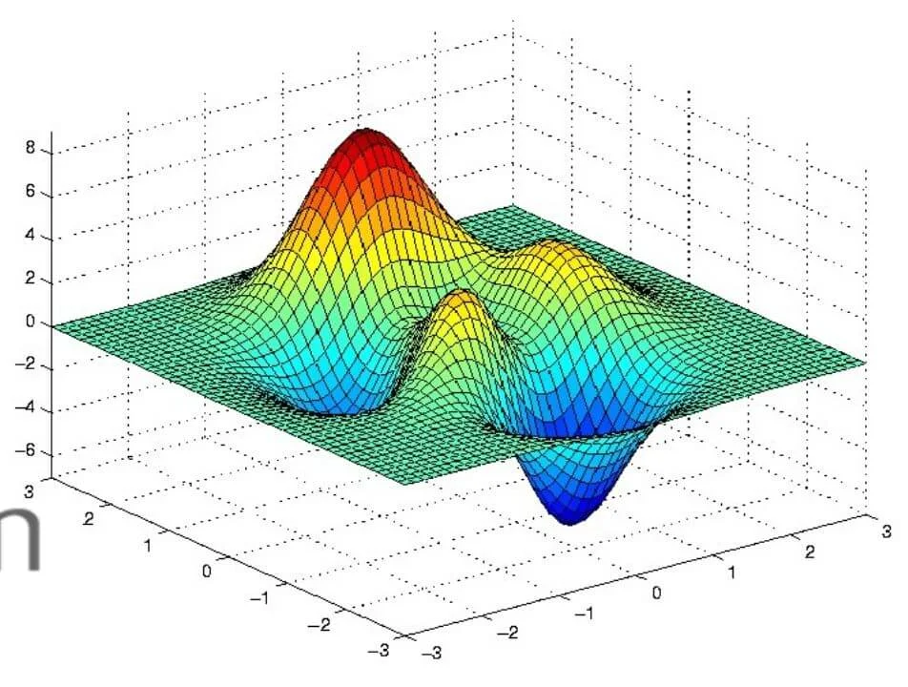
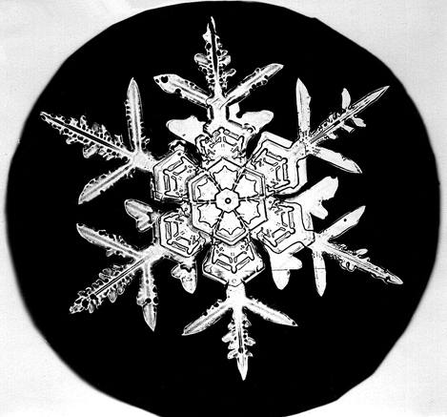
The Principle of Minimal Energy
This is how nature stores its patterns
F. Projcheski, “How to implement Gradient Descent in Python Programming Language | LacoincMl,” Laconic Machine Learning, Sep. 02, 2020. Available: https://laconicml.com/stochastic-gradient-descent-in-python/
Wikipedia contributors, “Snowflake,” Wikipedia, Oct. 02, 2024. Available: https://en.wikipedia.org/wiki/Snowflake#/media/File:Bentley_Snowflake4.jpg

Slide 10
Notion Behind
Neural Network
PME
An excellent example of a thinking machine
The fundamental principle of the world
The Hopfield Network

Slide 11
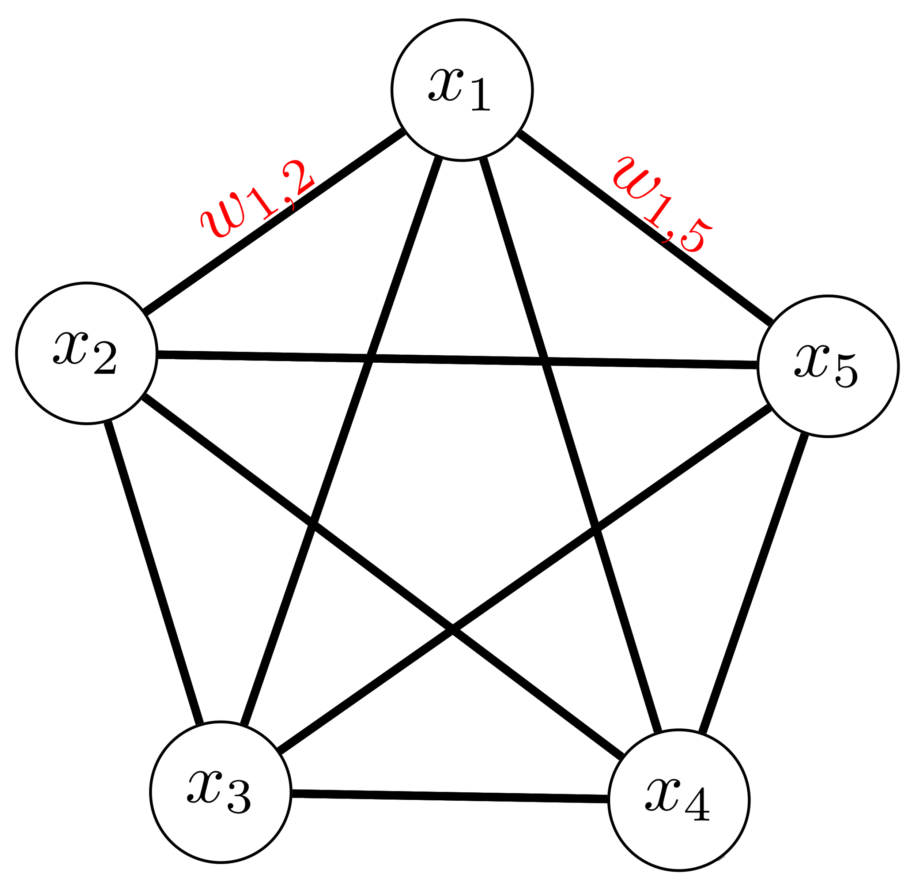
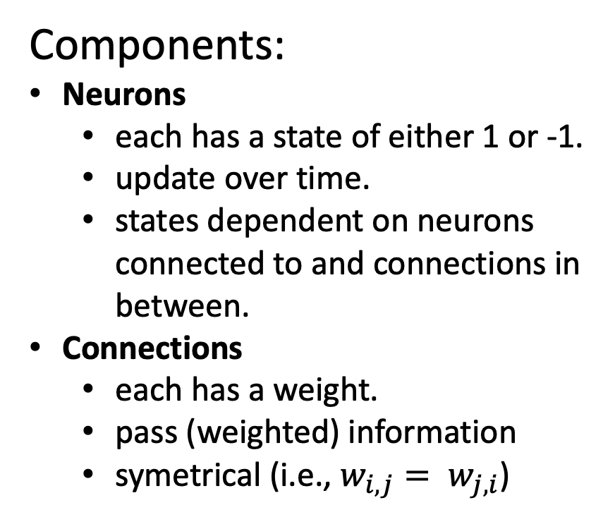
Structure
Components:
Neurons
each has a state of either 1 or -1.
update over time.
states dependent on neurons connected to and connections in between.
Connections
each has a weight.
pass (weighted) information
symetrical (i.e., $w_{i, j}= w_{j, i}$)

Slide 12
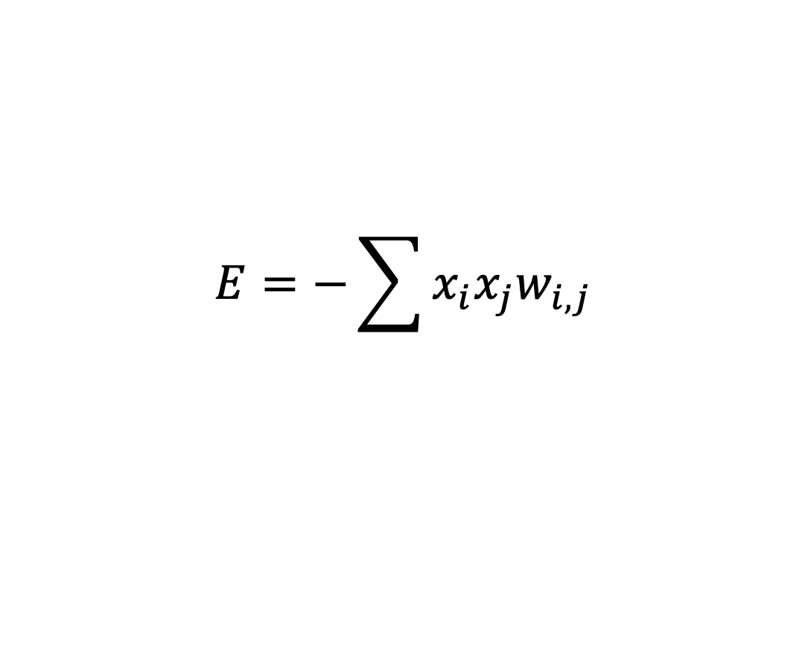
How does PME help learning & inferencing?
We first define the Energy of the network base on the idea:
The sign and magnitude of a connection’s weight shall represent the extent to which its connected neurons align / misalign.
$$E=−\sum{x_{i}x_{j}w_{i, j}}$$
+1
+
+1
This will soon make sense
+1
–
-1

Slide 13
Some Observations
Nature stores intricate information in the lowest energy states.
We can force the model to learn by minimizing its energy.
There is two type of parameters we can tweek.
This cooresponds to learning and recalling memories.

Slide 14
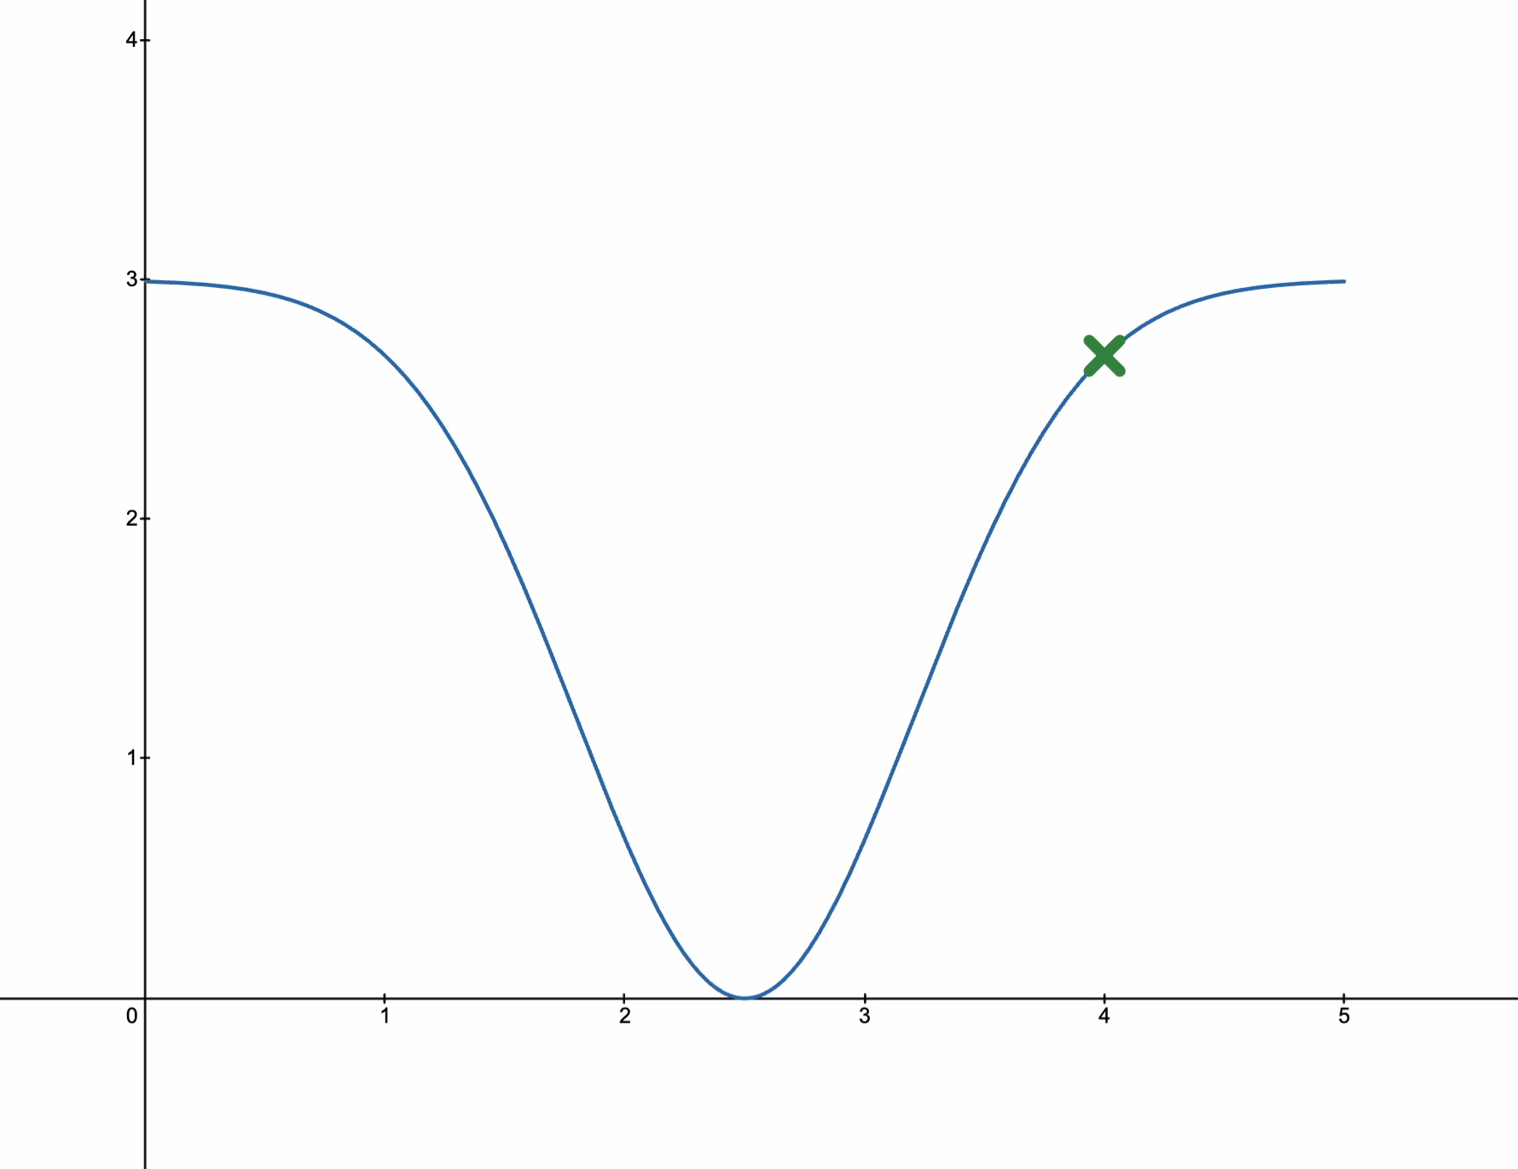
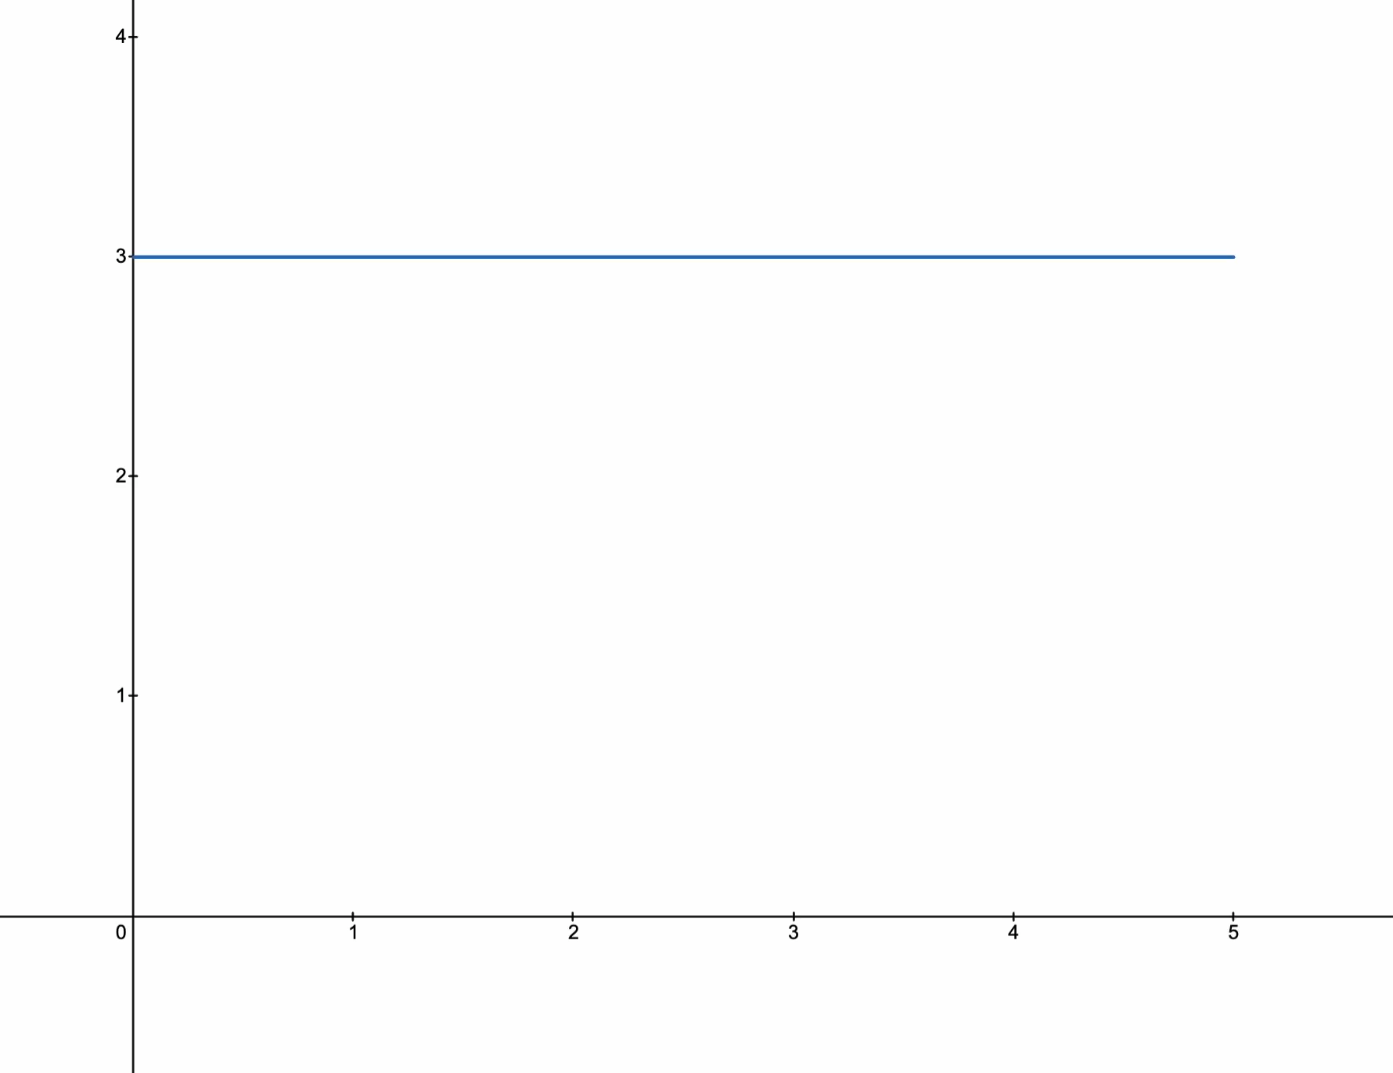
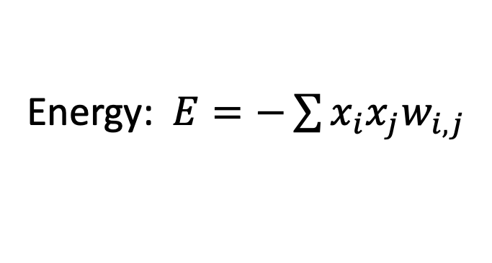
Visulization
Energy: $E=−\sum{x_{i}x_{j}w_{i, j}}$
We minimize the energy at this input by tweaking the weights.
We minimize the energy by tweaking the states of the neurons.
The HN now memorize the input as a minimum in the energy function.
We first feed the HN with some data.
It is not at the minimum because it is distorted
Now if we have a new input …

Slide 15
We will see how exactly the energy function is minimized next time.

Slide 16
Stay Tuned

